Slide 1
Module 4: Advanced Grouping
Version 1.6

Slide 2
Objectives
Adding summary rows
ROLLUP
CUBE

Slide 3
ROLLUP
Adds additional grouped rows progressively for each level named in GROUP BY clause.
Lower levels are summarised and shown as NULL.
Notes:
Rollup
Rollup adds additional rows for the groups listed in the GROUP BY clause
Working from right to left in the GROUP BY would summarise the remaining group by columns regardless of the value in the current column
The summary rows are shown as NULL for the ignored columns
This process is normally handled by the client tool rather than using ROLLUP
used for summing up

Slide 4
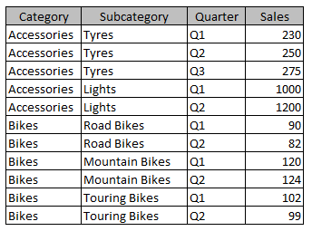
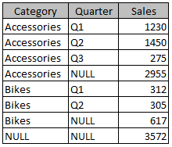
ROLLUP
SELECT Category, Quarter, SUM(Sales) AS TotalSales
FROM SalesSource
GROUP BY Category, Quarter
WITH ROLLUP
Notes:
In the example a table called SalesSource is queried, returning columns for the category name, quarter, and the sum of the sales amount. In the GROUP BY clause the words WITH ROLLUP are used, resulting in additional rows in the result set. The row with NULL values in the Category and Quarter columns represents a grand total. The rows containing category names and NULL values for the quarter are totals for each category. Note that if the GROUP BY clause had been written as “GROUP BY Quarter, Category” the results would have still shown a grand total, but a total for each quarter instead of each category.

Slide 5
CUBE
Adds additional grouped rows for combinations of levels named in GROUP BY clause.
Grouped levels are shown as NULL.
Notes:
Cube
Cube adds additional rows for the groups listed in the GROUP BY clause
Working with all combinations of zero or more, columns in the GROUP BY would summarise the select columns regardless of the remaining column in the GROUP BY
The summary rows are shown as NULL for the ignored columns
This process is normally handled by the client tool rather than using CUBE, such as a matrix in SQL Server Reporting Services (SSRS) or Power BI.

Slide 6
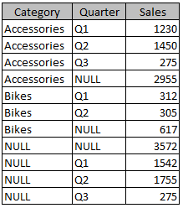
CUBE
SELECT Category, Quarter, SUM(Sales) AS Sales
FROM SalesSource
GROUP BY Category, Quarter
WITH CUBE
Notes:
The example shows a query based on the SalesSource table – on the left - selecting the category name, quarter, and the sum of the sales amount, grouped by category and quarter. The WITH CUBE clause returns additional rows in the result set. The row with NULL values in the Category and Quarter columns represents a grand total. The rows with category names and NULL values in the Quarter column represent totals for each category. The rows with NULL values in the Category column and quarter names represent totals for each quarter.

Slide 7

Review
Adding summary rows
ROLLUP
CUBE
GROUPING SETS

